Slide 1
Quantum liar’s dice
By Anandatheertha Bapu and Nurali Bibolat

Slide 2
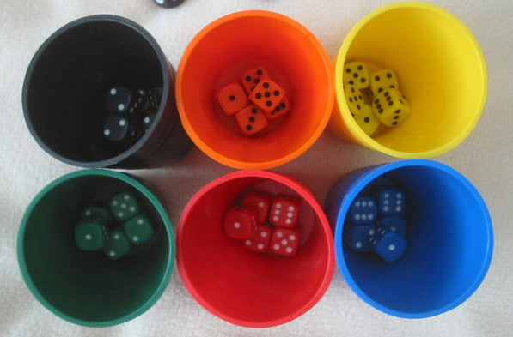
Classical Liar’s Dice
Played by 2 or more players.
Each player can see his/her own dice but not others.
Players bid by claiming a specific number of specific dice value(four 2s)
Players raise bid by increasing number of dice or the dice value
Players can challenge bid and bidding is over
Loser loses a die
Game continues until only one player has a die

Slide 3
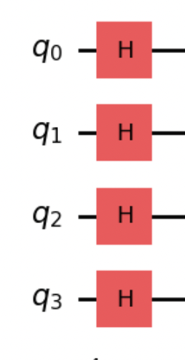
Quantum Randomness
4 sided dice
2 qubits to represent each dice
x players, y dice per player means 2 * x * y qubits
Hadamard qubits to give each dice combination equal value.

Slide 4
Quantum collusion
Players collude or work together so that if 1 players dice is a specific value, another player’s dice must be some value
Apply a controlled Hadamard along with a series of not gates.
Hadamard’s are their own inverse so a qubit will become 0, if the control qubit is 1.
Note that the original player’s dice still remains fully random.
Player does not know which dice will entangle(just knows what value and that will)
QASM doesn’t recognize ch gate

Slide 5
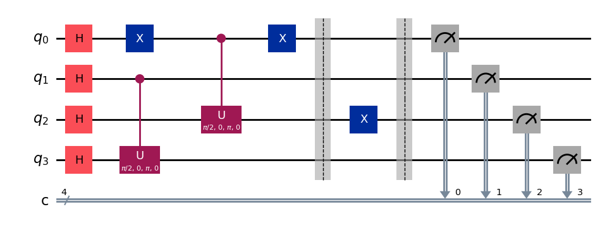
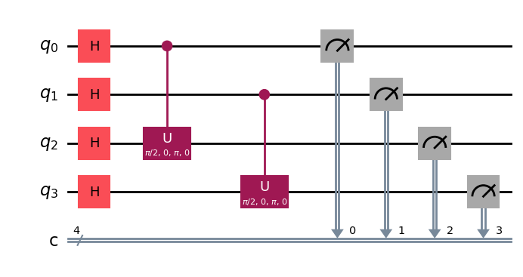
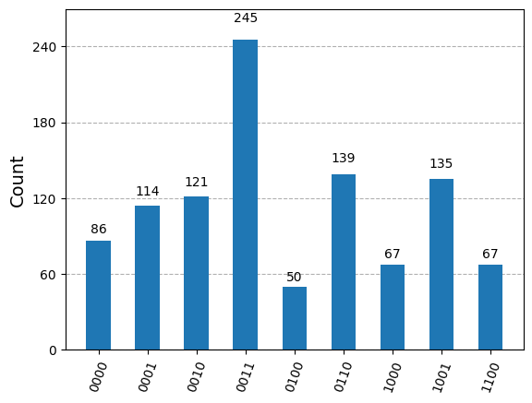
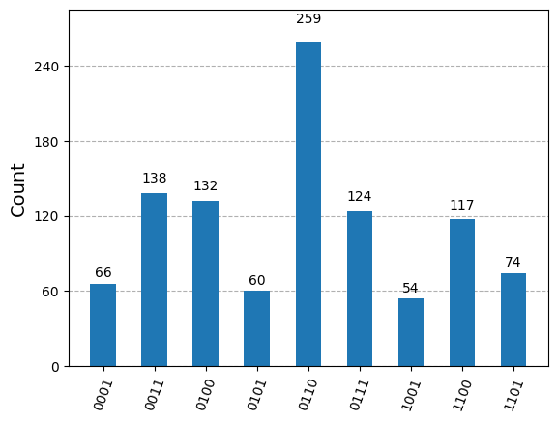
Quantum Collusion (continued), examples
If player 1 has a 4, then player 2 will have a 1:
If player 1 has a 3, then player 2 will have a 2:

Slide 6
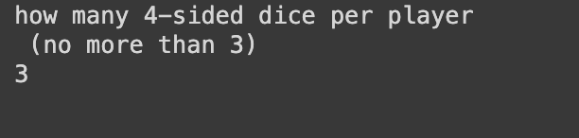
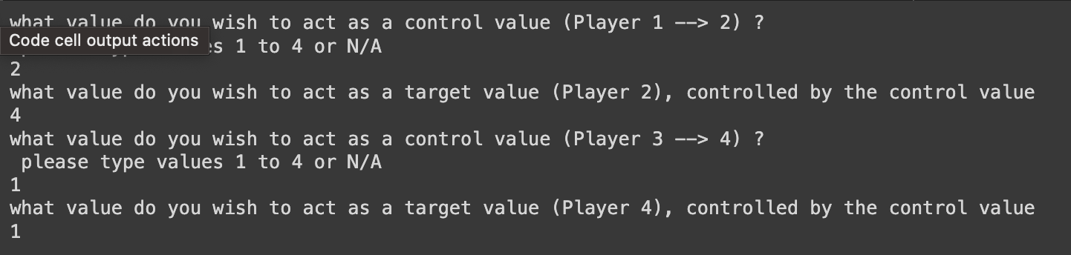
Playing the game
The players input the number of dice per player.
The players input which dice values they would like
Players are revealed the dice values, bid and input who loses.

Slide 7
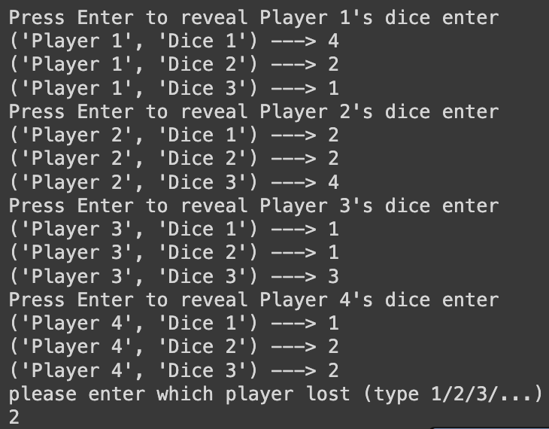
THANK YOU!!!

